Slide 1
God’s Plan of Salvation for All People
Your abundant life through the good news of Jesus Christ

Slide 2
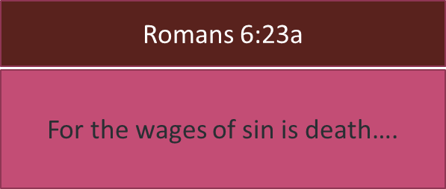
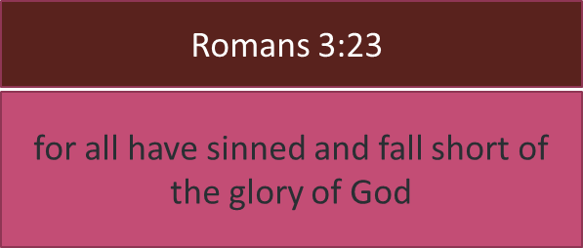
WE all Need Salvation
Everyone has a boatload of sins that have hurt others ourselves and God. We carry the guilt of those mistakes. You know that sin hurts. Powerfully unfortunate is that the punishment for sin is death. That’s God’s law Romans 3:23. Romans 6:23
Click the Bible reference to open and close.

Slide 3
God’s Plan for Salvation of every soul
"Therefore I said to you that you will die in your sins; for unless you believe that I am He, you will die in your sins."
“that if you confess with your mouth Jesus as Lord, and believe in your heart that God raised Him from the dead, you will be saved; for with the heart a person believes resulting in righteousness, and with the mouth he confesses, resulting in salvation."
3
You must confess Jesus, publicly your belief He is the Son of God, your Lord, and His resurrection.
Romans 10:9-10
1
Jesus is the Son of God. You must believe He is your Lord and God raised Him from the dead.
John 8:24
God graciously offers salvation to every soul, every person. While salvation is free by grace there are conditions that must be met. You know that god requires death for sin (Romans 6:23). That would be our death, for our sin. God has sent His Son Jesus to take the place of our death. He was crucified by the Jews and Romans over 2,000 years ago. He was buried in a rock tomb and guarded by Roman soldiers so that no one would steal His body and claim a false resurrection. But God assured us of the effectiveness of His death by Jesus’ true resurrection 3 days after His crucifixion just as He said would happen. By the power of God Jesus arose from death and came out of that tomb. He was seen by over 500 people. Jesus has overcome death for everyone who believes this, that He is the Son of God.
"He who has believed and has been baptized shall be saved; but he who has disbelieved shall be condemned.” Mark 16:16
Peter said to them, "Repent, and each of you be baptized in the name of Jesus Christ for the forgiveness of your sins; and you will receive the gift of the Holy Spirit.” Acts 2:38
“I tell you, no, but unless you repent, you will all likewise perish."
2
Your repentance is required – a change of mind for a change of life.
Luke 13:3
4
You must be baptized to wash your sins away. Jesus, the Lord, said so.
Mark 16:16
Acts 2:38
Click the Bible reference to open and close.

Slide 4
And Then?
We live in a way to please our Lord.
We attend church services with the Saints of God.
We live in a way to please our Lord.
We attend services with the Saints.
We glorify God through our behavior.
We love our church brothers and sisters.
We love those who have not come to Jesus for salvation. We share the gospel with them.
We live in love, light, and wisdom.
We glorify God by our behavior.
We love our church brothers and sisters.
We love the lost by sharing the gospel.
We live in love, light, and wisdom.

Slide 5
Matthews Street church of Christ
1915 Matthews St. Bay City, TX 77414
979.318.2463
garland.churchofchrist@gmail.com
9:30 Bible Class for everyone
10:30 Worship

