Slide 1
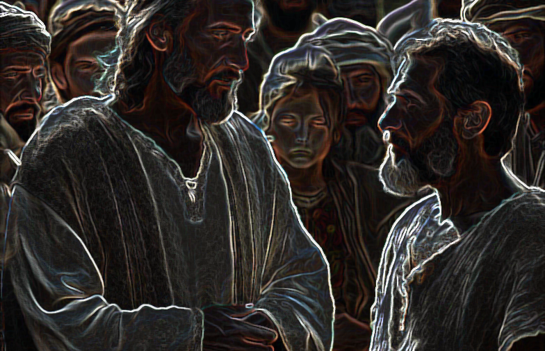
Jesus’ Purpose Luke 19:10

Slide 2
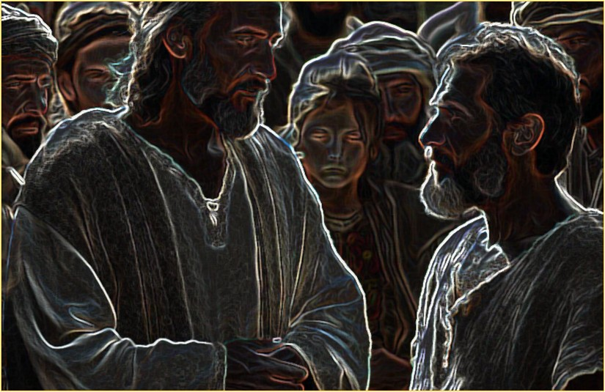
Man’s Problem with God
God’s Problem with Man
Jesus’ Purpose
For the Son of Man came to seek and to save the lost
Luke 19:10
Jesus’ Purpose 12/21/25

Slide 3
Core Purpose: Salvation from Sin
The New Testament teaches that Jesus came primarily to seek and save the lost by providing atonement for humanity's sins through His death on the cross, burial, and resurrection.
Key Biblical Statements:
Luke 19:10 — "For the Son of Man came to seek and to save the lost.“
1 Timothy 1:15 — "Christ Jesus came into the world to save sinners.“
Mark 10:45 — "For even the Son of Man came not to be served but to serve, and to give his life as a ransom for many.“
This mission addresses the universal human problem of sin, which separates people from God (Isaiah 59:1-2; Romans 3:23; 6:23). Without Jesus' sacrificial death as the perfect Lamb of God (John 1:29; Hebrews 9:22-28), no remission of sins would be possible. His blood purchases redemption (Acts 20:28; Ephesians 1:7), reconciling sinners to God.
Broader Aspects of His Mission
Jesus' earthly ministry also fulfilled broader aspects, such as:
Revealing God's will.
Teaching truth.
Performing miracles to confirm His identity.
Establishing His church/kingdom (Matthew 16:18-19).
His ultimate goal remains tied to salvation — He is the only way to the Father (John 14:6; Acts 4:12).
Response to Salvation
Salvation is not by faith alone (contrasting with many Protestant views) but involves obedient faith, mirroring New Testament examples of conversion (e.g., Acts 2, 8, 10, 16). The biblical
pattern includes:
Hearing the gospel (Romans 10:17).
Believing Jesus is the Son of God (John 8:24).
Repenting of sins (Acts 17:30). Confessing faith in Christ (Romans 10:9-10).
Being baptized (immersed) for the forgiveness of sins (Acts 2:38; Mark 16:16; 1 Peter 3:21).
Living faithfully (Revelation 2:10). Baptism is viewed as the moment one contacts Christ’s saving blood (Romans 6:3-4), is added to His church (Acts 2:47), and receives the gift of the Holy Spirit.
Jesus' purpose extends into the present through His church, which exists to continue seeking and saving the lost by proclaiming the same gospel (Matthew 28:18-20; Ephesians 3:10-11).
The church's mission mirrors Christ's: evangelism and faithful obedience to God's word, without social or political agendas beyond what Scripture authorizes. This emphasis on restoring "primitive Christianity" drives Churches of Christ to focus on Jesus as the divine Son who died for sins, rose victorious, and calls all to obedient faith for eternal life.
Matthews St. church of Christ; 1915 Matthews St., Bay City, TX 77414 www.matthewsstreetchurchofchrist.com

