Slide 1
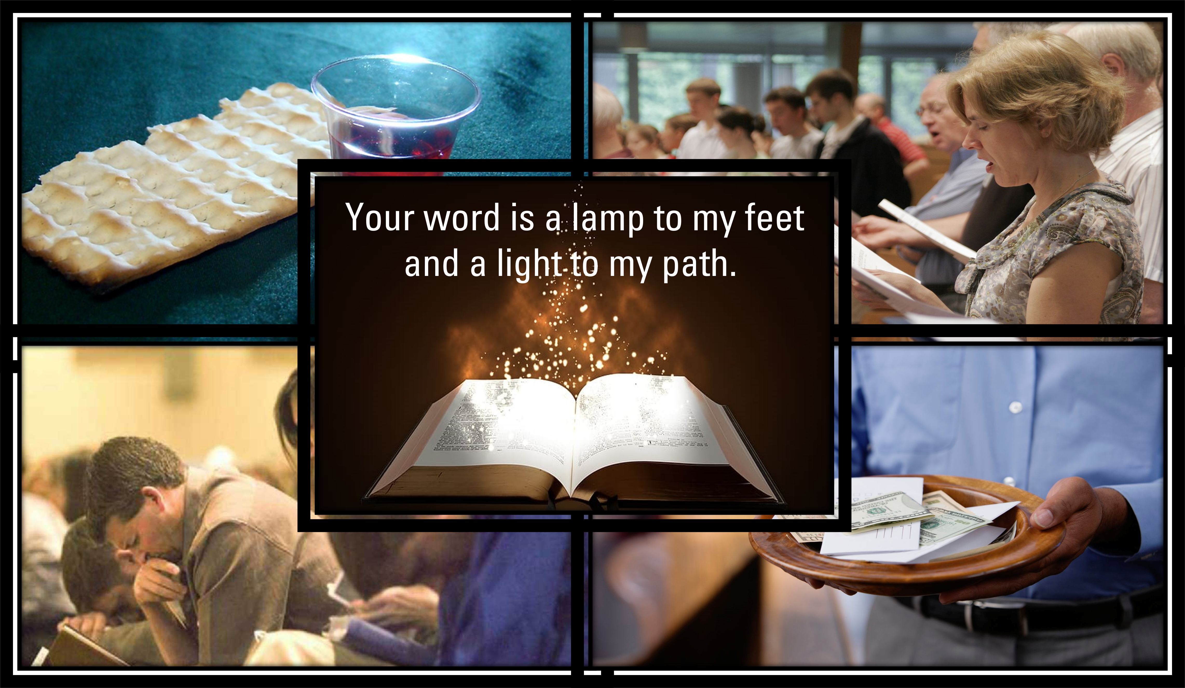

Slide 2
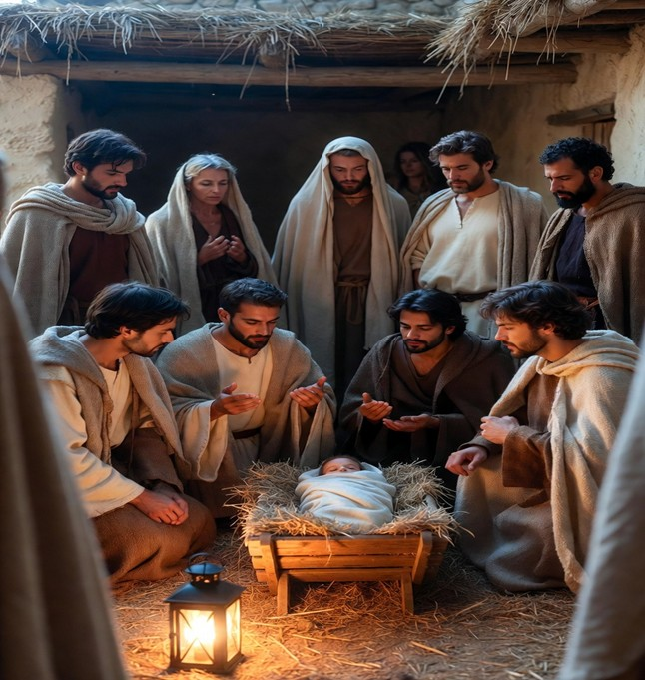
The Magi Story Matthew 2:1-11

Slide 3

They Sought
They Worshipped
They Gave Gifts
After entering the house, they saw the Child with Mary, His mother, and fell to the ground and worshiped Him. Then, opening their treasures, they presented to Him gifts of gold, frankincense, and myrrh.
The Magi Story 01/18/26

Slide 4

Matthew 2:1-11
When the Magi entered the house (not a stable—the Bible indicates this visit happened sometime after the birth), they found the young child Jesus with his mother Mary. They bowed down and worshiped him, then presented their famous gifts: Gold — symbolizing Jesus' kingship, Frankincense — a fragrant incense, symbolizing his divinity/priestly role, and Myrrh — a spice used for burial/anointing, foreshadowing his death.
Significance
The Magi represent the first Gentiles (non-Jews) to worship Jesus, showing that his coming was for all nations, not just Israel. Their journey illustrates seeking truth, recognizing Jesus' worth, and offering the best in worship—contrasting sharply with Herod's fear and hostility.
Matthews St. church of Christ; 1915 Matthews St., Bay City, TX 77414 www.matthewsstreetchurchofchrist.com
PO Box 1522

