Slide 2
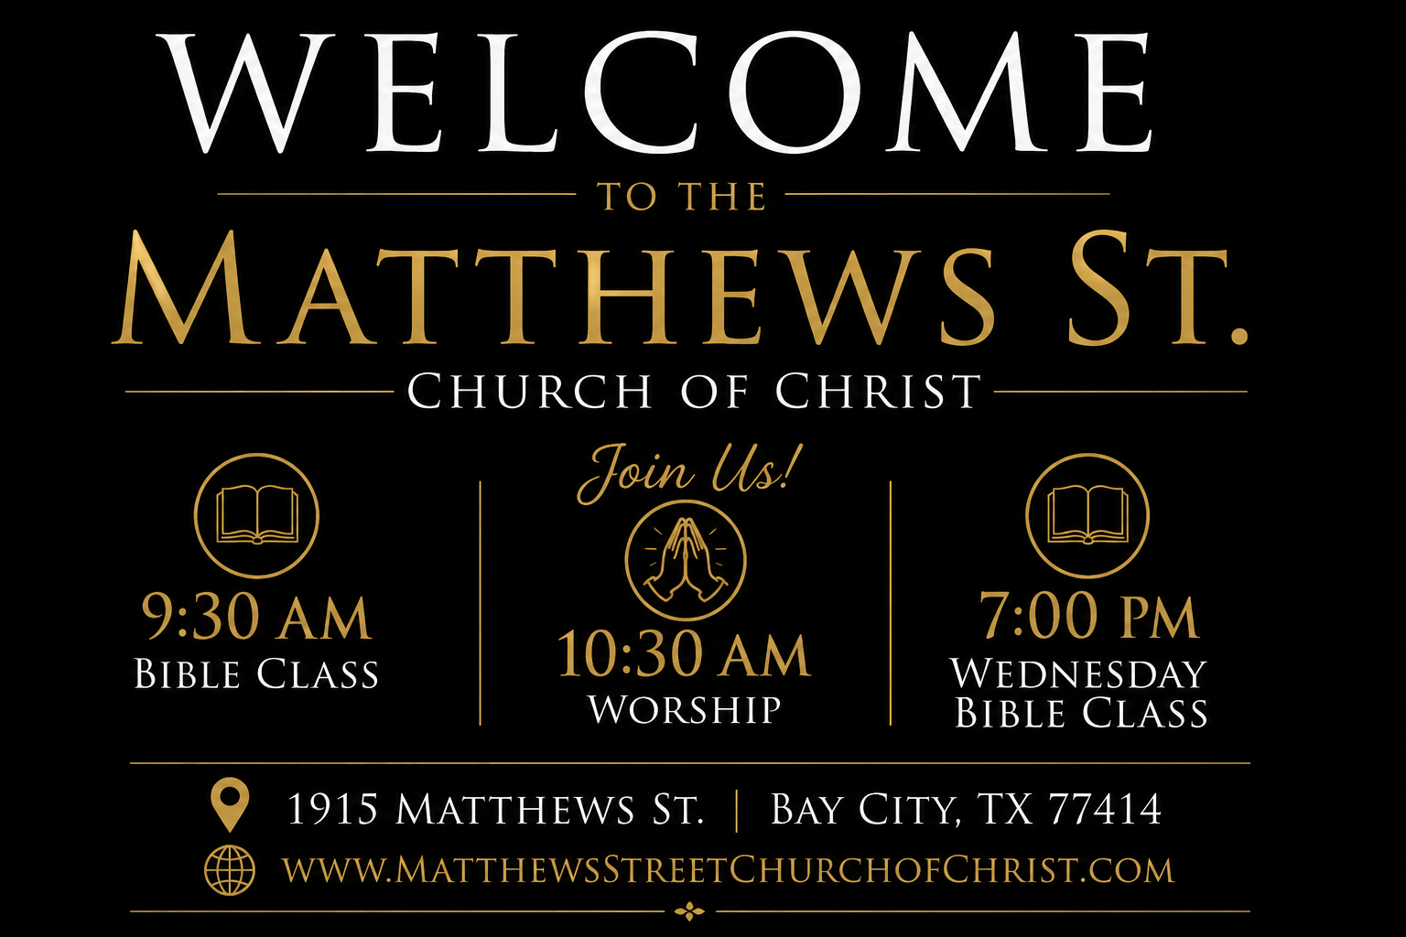

Slide 3
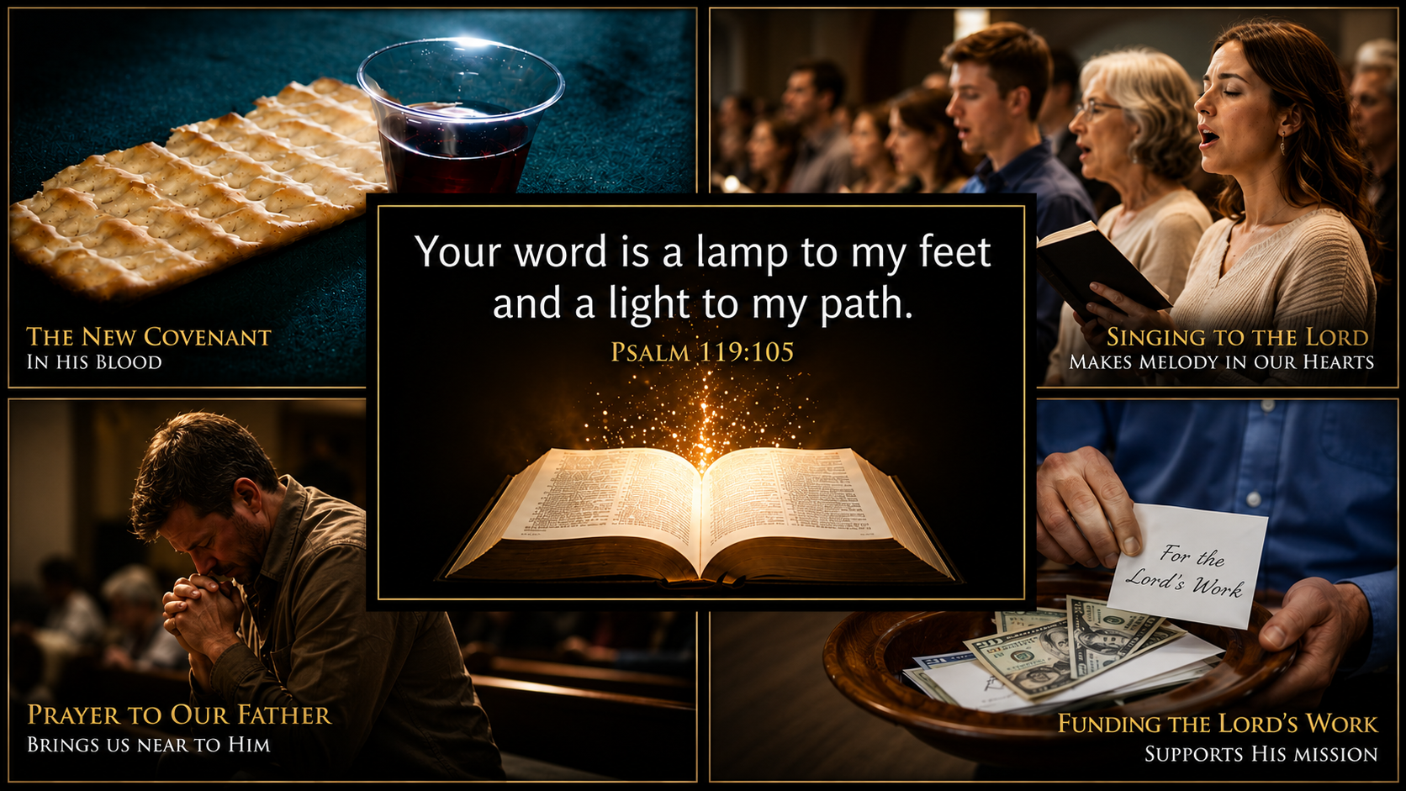

Slide 4
This Is My Story
Blessed Assurance!
This is my story, this is my song,
Praising my Savior all the day long.
Psalm 66:16
  “Come and hear, all who fear God,
  And I will tell of what He has done
  for my soul.”

Slide 5
Psalms 66:16
Come and hear, all you who fear God, and I will tell what he has done for my soul.
A. Cried
B. High Praise
Verse 17
A. Sins / Heart
B. No Hearing
Verse 18
A. Listened
B. Prayer
Verse 19
I cried to him with my mouth, and high praise was on my tongue.
If I had cherished iniquity in my heart, the Lord would not have listened.
But truly God has listened; he has attended to the voice of my prayer.
Blessed be God, because he has not rejected my prayer or removed his steadfast love from me!

Slide 6
